Slide 1
Scripting in Linux
Scripting Fundamentals

Slide 2

Course Topics
Changing the mode of a file
Conditionals in Linux
Loops in Linux
Switch Statements
Using Arrays

Slide 3
Changing the ‘mode’ of a file
We can create files as scripts in Linux, but we need to change the mode of the file before we can execute it
We can use the chmod command to do this
Chmod can be used to dictate the usage of a file – read, write, execute, etc.
Running the command chmod +x [filename] will allow this file to be executable

Slide 4
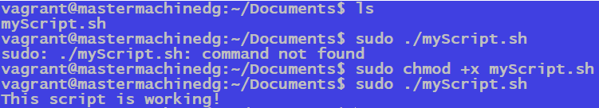
Chmod in Linux
Breaking down this set of commands…:
We first list the contents of the directory – and we can see that there is a script file there
We then try to execute this file with the dot-slash notation, which evidently doesn’t work
We then change the mode of the file with chmod, and make it executable
Finally, we use the dot-slash notation to run the file again, which now works!

Slide 5
Scripting Logic
Scripting in Linux operates very similarly to other programming languages
Supports conditionals, variables, loops, case statements, etc.
The syntax is slightly different, but the general usage is the same
There are a few things to note with square brackets, keywords and interpreters

Slide 6
Using # in shell scripts
Use # as part of the header
A sub-shell is used to run a script
The Bourne shell is used by default, unless the header says otherwise
Headers allow to integrate scripts written in different shells
Use # for comments in scripts
Shell scripts are programs and should be annotated with comments
Shell comment starts with # and extends to the end of the line
#!/usr/bin/bash
date
uname –a
hostname
who –r # show runlevel
# user information
who
ps
Notes:
The #! syntax is a general mechanism, allowing to integrate a shell script into any other shell environment.
If an executable script file starts with #!, the next word is taken to be a program name to execute, and the program is executed with its standard input redirected to read from the rest of the script. You may be having a csh or bash session, and execute a bash written script.
Comments should be used within shell scripts to describe the functionality. It is always a good idea to begin a shell script with a general description of its function and any command-line parameters (see later) that are required. Use comments to clarify obscure or complicated commands.

Slide 7
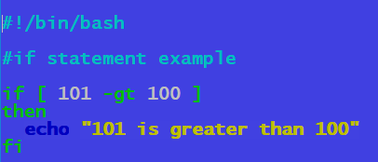
If Statements in Linux
Interpreter/Header
Comment
Condition
Action
A basic condition statement tests something
if it’s true, do a set of actions, if not, perform other actions
Note the use of square brackets and spaces between the brackets and the statement
Notes:
Important things about scripts:
Condition has to be in square brackets
There needs to be spaces between the square brackets and the condition
We can also use the else keyword for an alternative set of actions
If we want multiple alternatives, use the elif keyword
End the condition with the fi keyword
Make sure to have the interpreter at the top!

Slide 8
Numerical Comparison
We can’t use symbols such as =, !, and > within numerical comparisons
Rather, we need to use flags
-ne – not equal
-eq – equal
-gt – greater than
-ge – greater than or equal to
-lt – less than
-le – less than or equal to

Slide 9
User Input in Scripts
When writing scripts, there may be times where we want user input
The way we can do that within a script is with the use of echo and read
We can echo some form of prompt telling the user what to do
We can then use the read keyword to read the next set of characters and assign it to a variable

Slide 10
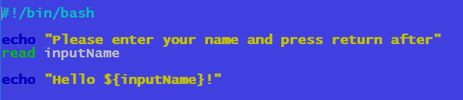
User input with Read
Interpreter
Echo Statement
Reading the value with the read keyword and adding it to the variable inputName
Referencing the variable we created
We use an echo statement to add some context to the script, but it isn’t actually necessary
We then use the read keyword to read the next stream of characters and put them into the inputName variable
Finally, we encapsulate the variable in curly braces so we can use it

Slide 11
Loops in Scripts
Loops are very useful in programming to run a piece of logic for a duration based on condition
Bash supports a number of looping methods, such as:
For loops
While loops
Until loops
You can utilise a notation similar to Java for your for loops in bash too
for (initialiser; condition; increment/decrement)

Slide 12
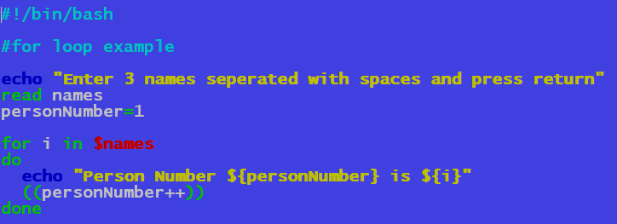
For Loop in a bash Script
Echo and read statements
Using the variable “i” to loop through the items in the names variable
Incrementing the personNumber value for the loop
We start with an echo/read to get our user input, as well as create another variable personNumber
We then declare our for loop, using the variable “i” to loop through all of the items in the names variable
We need to use the do keyword to specify the action of the loop, which we’re echoing and incrementing

Slide 13
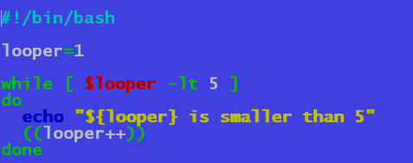
While Loop in a bash Script
Interpreter and variable declaration
While condition that will run the actions whilst eh condition is true
Incrementing the value in the looper variable
We make a variable called looper, and assign it the value of 1
Similar to an if statement, we have our while condition in square brackets, followed by the do keyword
We then have our actions, including the incrementation of the looper variablle

Slide 14
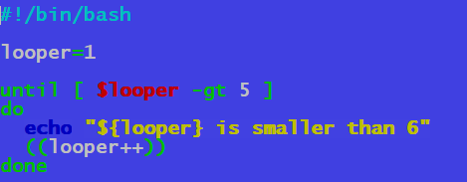
Until Loop in a bash Script
Interpreter and variable declaration
Until condition that will run the actions until its met
Incrementing the value in the looper variable
We make a variable called looper, and assign it the value of 1
The general syntax is very similar to a while statement
The loop continues until the condition is met, rather than while it is true

Slide 15
Switch/Case Statements
Switch/Case statements are good for scripts that have defined conditions
Having loads of if/elif statements is quite cumbersome, so we can use a switch/case statement instead
We can also have a default clause if none of the cases are met – based on the variable
case $variable in
case 1) action
case 2) action
case 3) action
case n) action
*) default action
esac

Slide 16
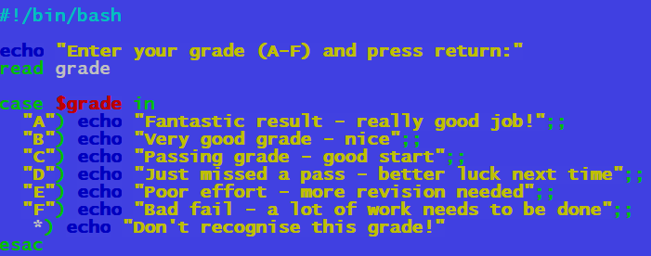
Switch/Case Statement in Bash
We start with the same echo/read process we have done for the script to get a variable from the user
We then declare our switch/case statement, based on the variable we created
From here, we add all cases to switch between based on our variable
We can also have a default case, symbolised with the asterisk symbol

Slide 17
Arrays in Bash
Arrays are also used in bash to contain a number of elements
Works well with the loop concepts earlier
Each item in the array is indexed from 0 onwards, which can then be used to iterate through an array
We need to use the built-in keyword declare if we want to make a variable that is to be used as an array

Slide 18
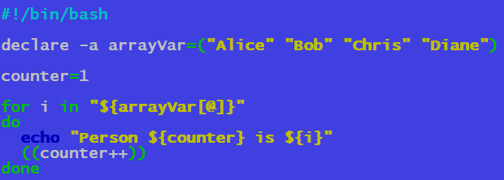
Until Loop in a bash Script
Interpreter header
Creating an array with the declare shell built-in
Iterating through the array based on index, which is referenced through the @ character
We need to use the declare variable, which allows us to modify the properties of a variable
We also specify the –a flag, to specify that we are creating an array. From here, we add in our elements
We need to use the array variable based on its index in our loop, which is referenced with the @ symbol

